Slide 1




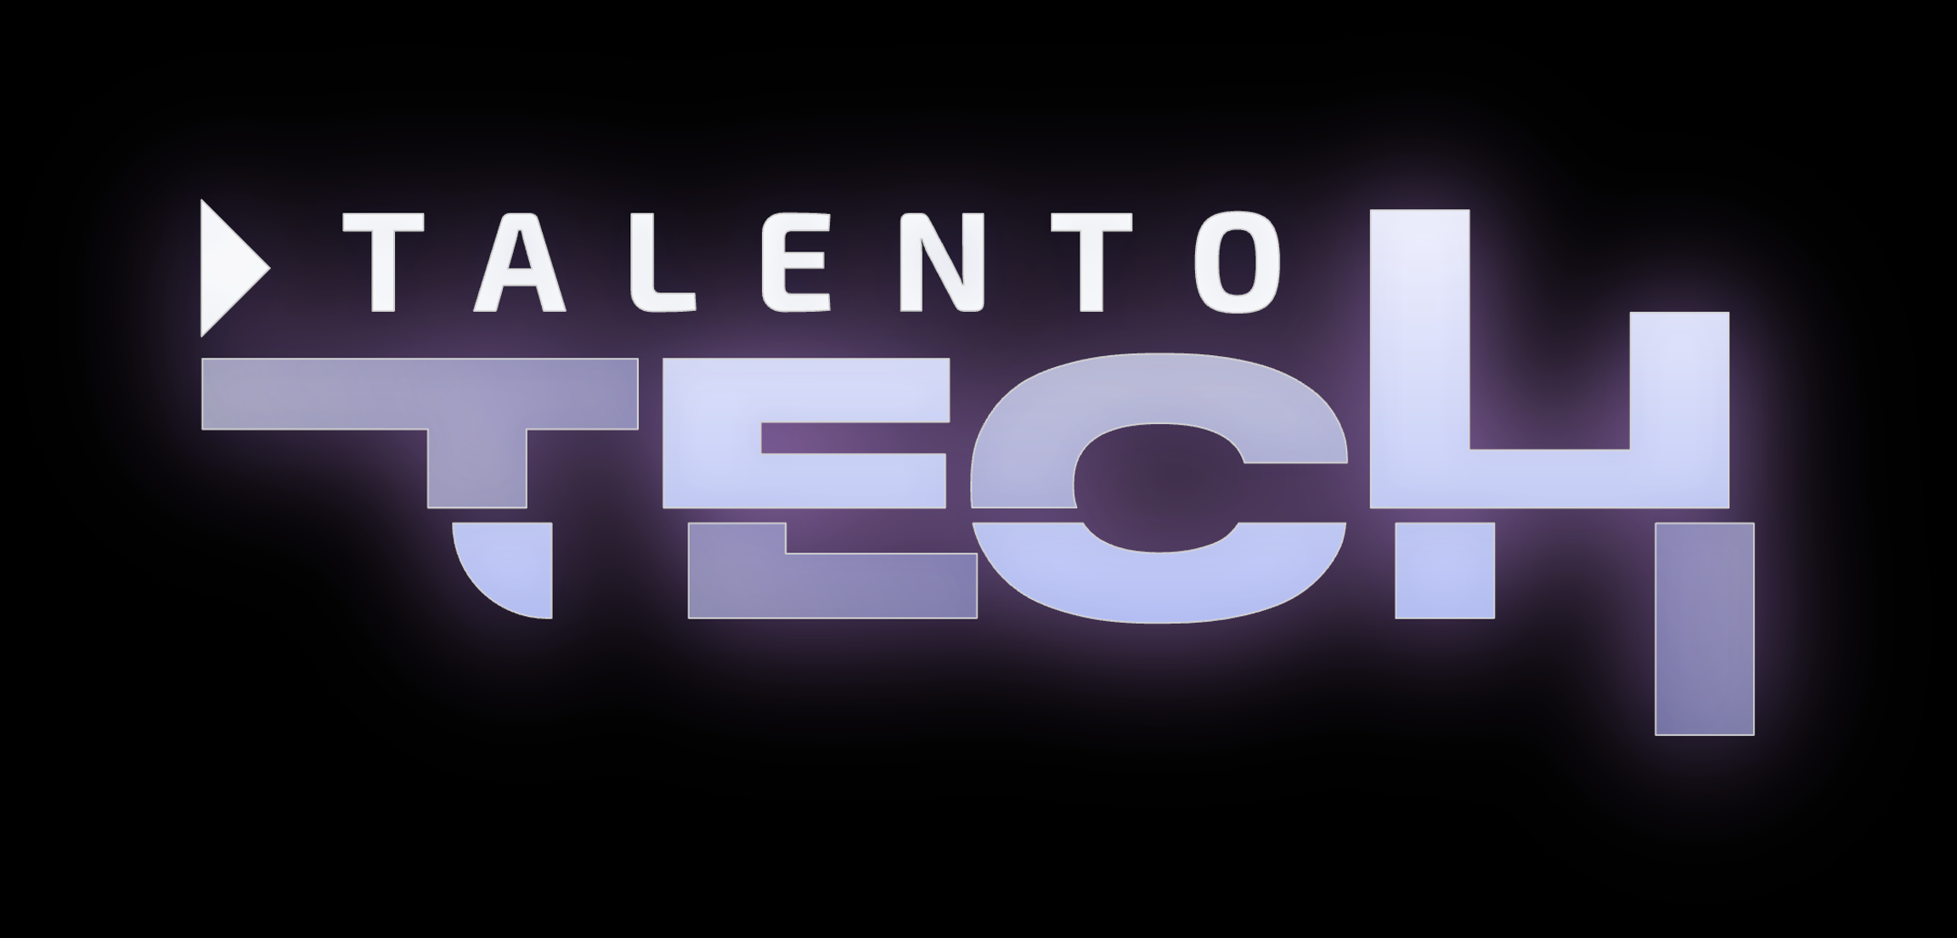

Bootcamp
The World of IT 1
Basic Level
CAROLINA GOMEZ MELENDEZ
May 22nd, 2024

Slide 2
LET’S CHECK WHAT WE STUDIED LAST CLASS
Jobs in IT
IT
Questions
New Vocabulary
https://wordwall.net/es/resource/70603592/tech-interview-wh-questions-word-order
Notes:
Verbs in past review: https://wordwall.net/es/resource/34704781/crossword-past-simple-verbs

Slide 3
Table of content
1
Review
2
The World of IT
3
Pronouns and Determiners

Slide 4

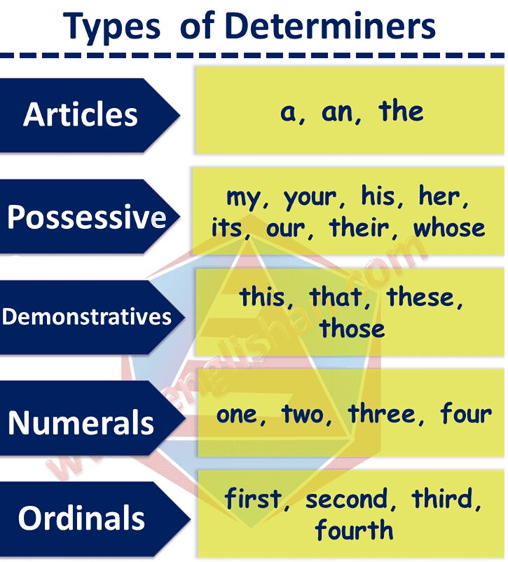
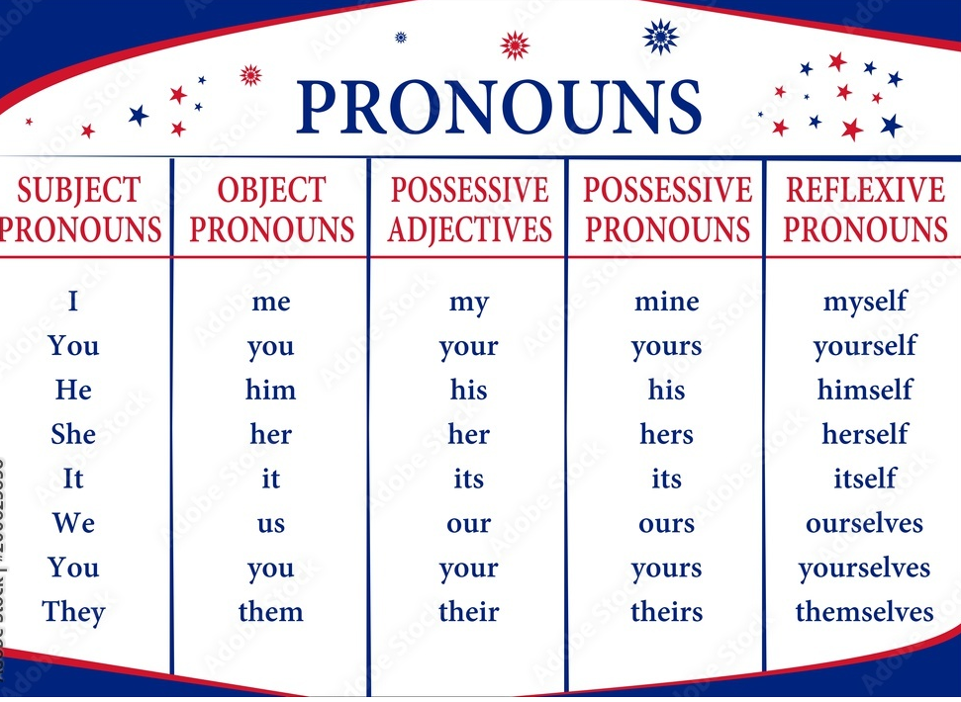
Determiners and pronouns
Read and understand.

Slide 5
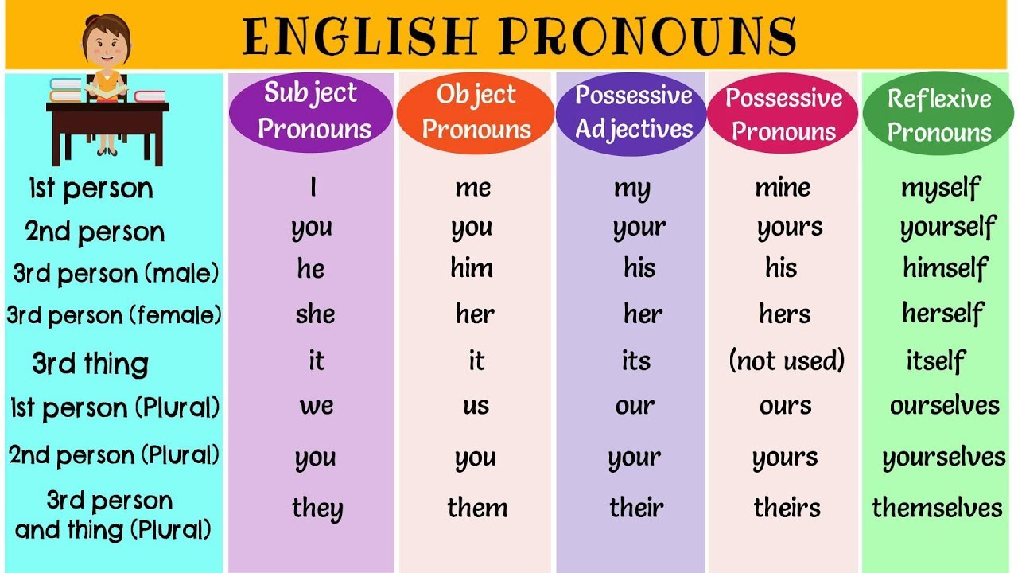
Grammar Pill

Slide 6
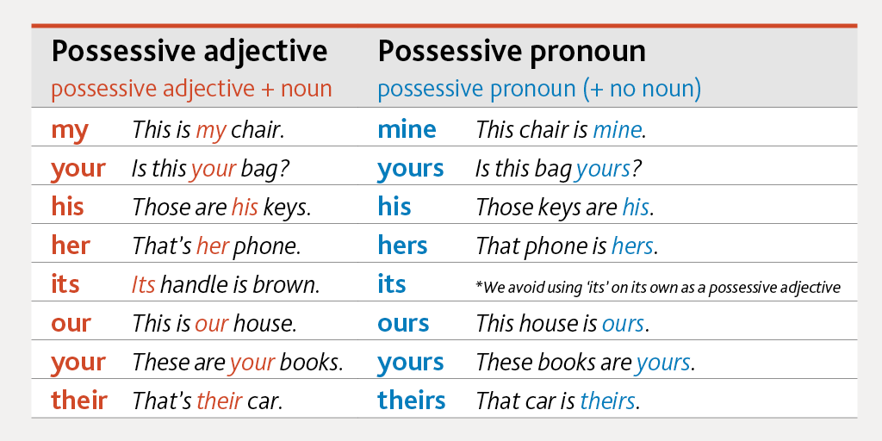
Grammar Pill- Examples
https://agendaweb.org/exercises/grammar/possessive/determiners-write-3.htm
https://agendaweb.org/exercises/grammar/possessive/write.htm

Slide 7
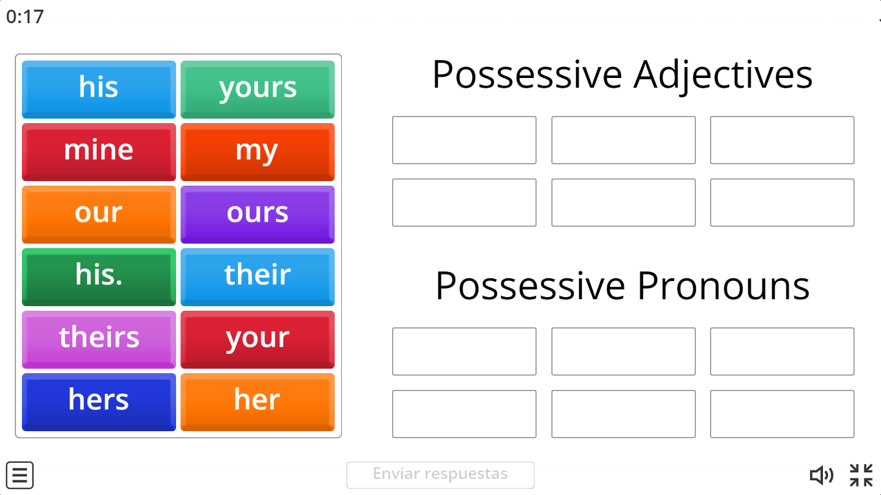
Let’s Practice
https://wordwall.net/es/resource/15833517/possessive-adjectives-and-possessive-pronouns

Slide 8
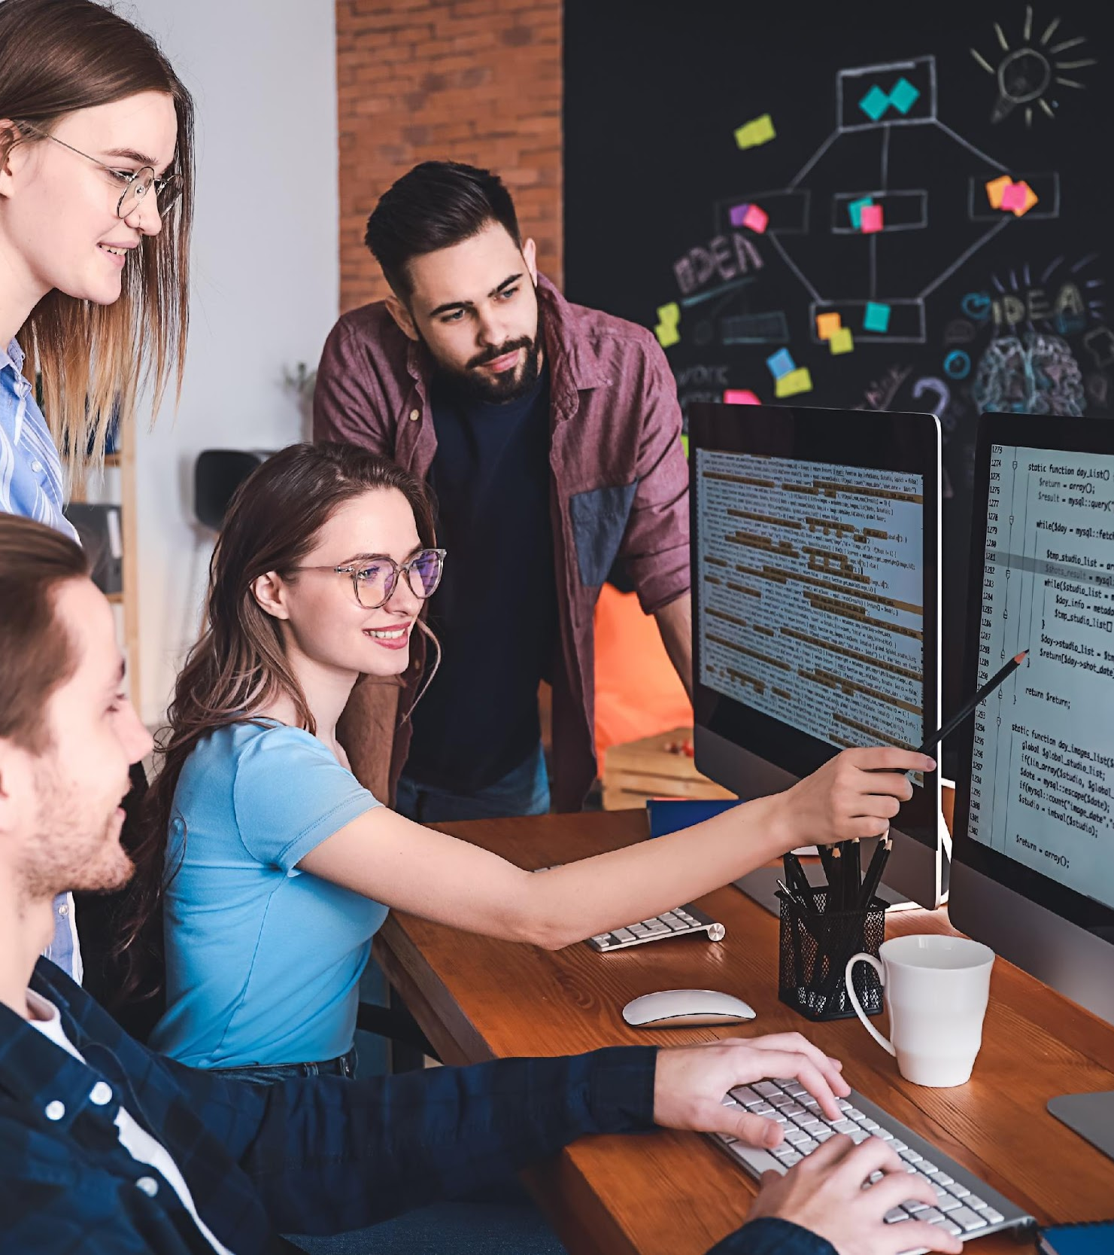
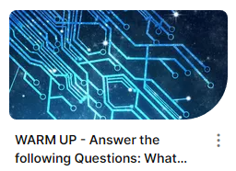
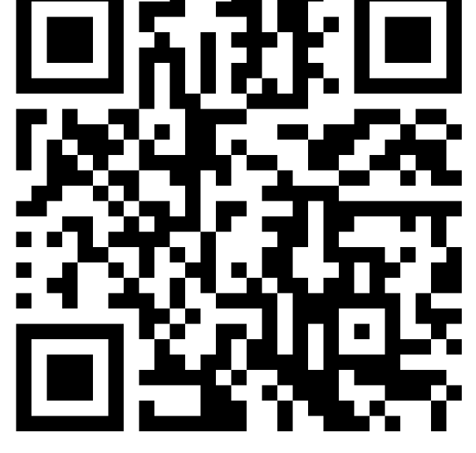
Discuss the following questions.
https://padlet.com/gomelendezcarolina/group-167-answer-the-following-questions-what-kinds-of-techn-92bmlg407fzkfxis

Slide 9
Practice
Fill in the blanks using an appropriate determiner or pronoun from the box: their, the, a, these, first, it.
The origins of information technology trace back to ancient civilizations, where humans initially served as "computers," performing computational tasks manually. _____ invention of machines revolutionized _____ processes, leading to the development of modern information technology. _____, information tethered to physical forms, then _____ has transcended boundaries, becoming _____ disembodied and accessible issue from anywhere through advancements like cloud technology. Recent strides in IT owe _____ existence to the continuous refinement of computing systems.

Slide 10
Practice
Fill in the blanks using an appropriate determiner or pronoun from the box: their, the, a, these, first, it
The origins of information technology trace back to ancient civilizations, where humans initially served as "computers," performing computational tasks manually. _____ invention of machines revolutionized _____ processes, leading to the development of modern information technology. _____, information tethered to physical forms, then _____ has transcended boundaries, becoming _____ disembodied and accessible issue from anywhere through advancements like cloud technology. Recent strides in IT owe _____ existence to the continuous refinement of computing systems.
The
these
First
it
a
their

Slide 11
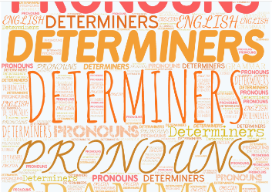
DETERMINERS & PRONOUNS
Choose the best option to complete the sentences.
Play here
https://create.kahoot.it/details/b3495851-d9f0-4797-85c1-bdeb27366c95
Notes:
Game: https://www.baamboozle.com/game/1426936

Slide 12


Watch
Watch the following video.
https://www.youtube.com/watch?v=cWNEZLbP9Lk

Slide 13

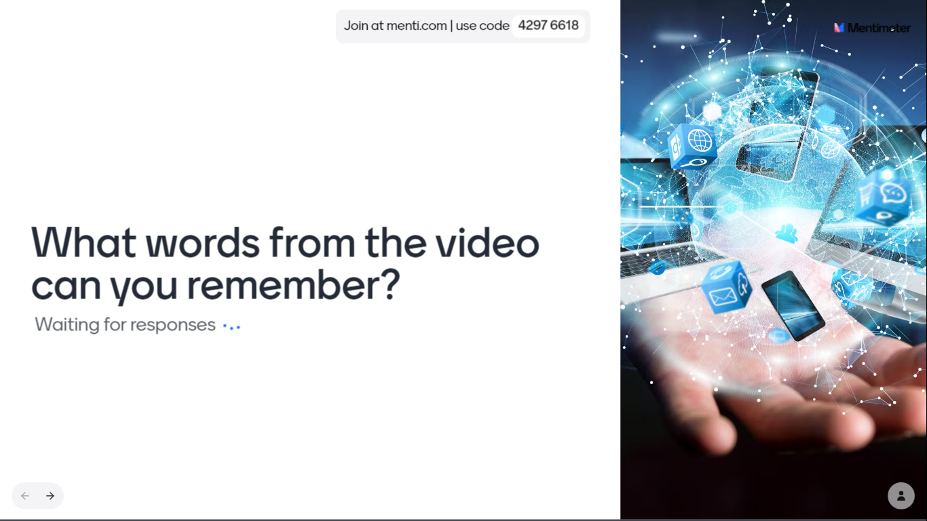
Share
Based on the video, type a word, you remember from it.
https://www.menti.com/almnzd1qb65o
Notes:
Answers to the comprehension questions:
1. Bob's main concern regarding robots and automation is that they will take over jobs, leading to unemployment and potentially causing societal upheaval.
2. The speaker counters Bob's concerns by pointing out that technological advancements have historically led to increased efficiency and prosperity, and that humans have adapted to these changes by learning new skills.
3. The speaker uses the example of the Industrial Revolution to illustrate the impact of technological advancements on employment, highlighting how automation has led to fewer people working fewer hours to achieve greater prosperity.
4. Some benefits of automation mentioned in the text include increased efficiency, reduced workload, and the ability to perform tasks that are difficult, dirty, dangerous, or time-consuming.
5. The speaker suggests that humans adapt to technological advancements by learning new skills and finding new opportunities, ultimately benefiting from having their previous jobs done by machines.

Slide 14
Reading
Read the following text.
Information technology (IT) is the use of any computers, storage, networking and other physical devices, infrastructure and processes to create, process, store, secure and exchange all forms of electronic data.
The IT department ensures that the organization's systems, networks, data and applications all connect and function properly.
The IT team handles three major areas:
deploys and maintains business applications, services and infrastructure (servers, networks, storage);
monitors, optimizes and troubleshoots the performance of applications, services and infrastructure; and
oversees the security and governance of applications, services and infrastructure.
Most IT staff have different responsibilities within the team that break into several key areas including:

Slide 15
Administration. Administrators handle the day-to-day deployment, operation and monitoring of an IT environment, including systems, networks and applications.
Support. Help desk staff specialize in answering questions, gathering information and directing troubleshooting efforts for hardware and software.
Applications. Businesses rely on software to perform work. The trend toward agile or continuous development paradigms require developers to be increasingly involved with IT operations.
Compliance. Businesses are obligated to observe varied government- and industry-driven regulatory requirements. IT staff play a major role in securing and monitoring access to business data and applications.

Slide 16
Vocabulary Activity
Write down the following information from the text in the previous slides.
KEY VOCABULARY | DEFINITION/ SYNONYM
Infrastructure | Skeleton; the framework or features of a system or organization.
troubleshoot | Diagnose, analyse and solve.
paradigm | Another rules to solving problems
compliance | To align to standards or rules
rely | Depend on someone or something
Deploy | Leave a system working indepently
oversees | Supervises, observe
Handle | Manipulate with your hands
toward | direction

Slide 17
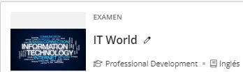
Reading Comprehension
https://quizizz.com/admin/quiz/6602155b76502623ec652e8b?source=quiz_share
Notes:
https://docs.google.com/document/d/1PO9UYf3V5UfpnbIzprW5E9OlegOGHoWq/edit?usp=sharing&ouid=107132437745420382364&rtpof=true&sd=true

Slide 18


